Slide 1

Object-Oriented Programming (OOP)
Lecture No. 4
Engr.Asma Khan
Assistant Professor
Software Engineering Dept
NED University Karachi

Slide 2
Recap of previous Lecture

Slide 3
Problems with Structured Programming
Functions have unrestricted access to global data
Function A:
Function B:
Function C:
local data
local data
local data
global data X
global data Y
global data Z
Large number of potential connections between functions and
data (everything is related to everything, no clear boundaries)
  makes it difficult to conceptualize program structure
  makes it difficult to modify and maintain the program
  e.g. : it is difficult to tell which functions access the data

Slide 4
Problems with Structured Programming
data and function are considered as two separate
entities
makes it difficult to model things in the real world
complex real world objects have both attributes and
behaviours
attributes
  people: name, date of birth, eye color, job title
  cars: horse power, number of doors, color
behaviours
  people: ask a person to bring you a beer
  cars: apply the brakes, turn on the engine
attributes and behaviors alone are sufficient to realistically
model real world objects but a unified view is needed

Slide 5
Object Oriented Approach
Object
functions
data
Encapsulation: integrate data and functions into one object
Data hiding : data is hidden to the outside world and can
only be accessed via the functions
In C++ functions are called membership functions in other
languages such as Smalltalk they are called methods
Data items are called attributes or instance variables

Slide 6
Object Oriented Approach
separation: objects interact with each other only via the their membership functions
separation helps to maintain the integrity of the entire
program
Object A
functions
Object C
data
Object B
functions
functions
data
data

Slide 7
Abstraction
An abstraction is a named collection of attributes and
behavior relevant to model a given entity for some
particular purpose
real-world
abstraction
software
{data, data,…}
attributes
entity
behavior
{ method, method…}

Slide 8
Separation of Interface and Implementation
independent specification of a visible interface and
a hidden implementation
interface is some kind of contract between the object
and the user of this object or module
separation is not restricted to object-oriented programming
for example header files in standard C can be regarded
as interfaces
visible
interface
hidden
Imple-
mentation

Slide 9
Structure of an Object
Interface
Implementation
Object
method
code
data
method
code
method
code
method
code

Slide 10
Examples of Objects
physcial objects
  vehicles in a traffic-flow simulation
  electrical components in a circuit-design program
elements of a computer user environment
  menus
  graphic objects
data-storage constructs
  arrays
  linked lists
human entities
  employees
  students
collections of data
  an inventory
  an address book
user defined data types
  time
  complex numbers

Slide 11
Recap – Inheritance
Derived class inherits all the characteristics of the base class
Besides inherited characteristics, derived class may have its own unique characteristics
Major benefit of inheritance is reuse

Slide 12
Concepts Related with Inheritance
Generalization
Subtyping (extension)
Specialization (restriction)

Slide 13
Generalization
In OO models, some classes may have common characteristics
We extract these features into a new class and inherit original classes from this new class
This concept is known as Generalization

Slide 14
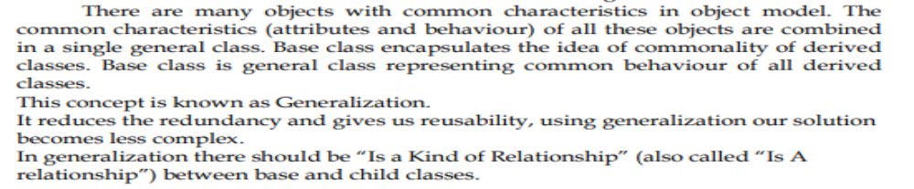
Example – Generalization
Line
color
vertices
length
Circle
color
vertices
radius
move
setColor
getLength
Triangle
color
vertices
angle
move
setColor
computeArea
move
setColor
computeArea

Slide 15
Example – Generalization
Shape
color
vertices
move
setColor
Triangle
Circle
radius
Line
angle
computeArea
length
computeArea
getLength

Slide 16
Example – Generalization
Student
name
age
gender
program
studyYear
Teacher
name
age
gender
designation
salary
Doctor
name
age
gender
designation
salary
study
heldExam
eat
walk
teach
takeExam
eat
walk
checkUp
prescribe
eat
walk

Slide 17
Example – Generalization
Person
name
age
gender
eat
walk
Student
Teacher
Doctor
program
studyYear
designation
salary
designation
salary
study
heldExam
teach
takeExam
checkUp
prescribe

Slide 18
Sub-typing & Specialization
We want to add a new class to an existing model
Find an existing class that already implements some of the desired state and behaviour
Inherit the new class from this class and add unique behaviour to the new class

Slide 19
Sub-typing (Extension)
Sub-typing means that derived class is behaviourally compatible with the base class
Behaviourally compatible means that base class can be replaced by the derived class

Slide 20
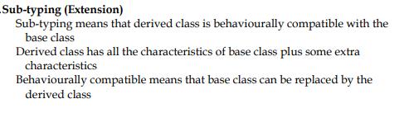
Example –
Sub-typing (Extension)
Person
name
age
gender
eats
walks
Student
program
studyYear
study
takeExam

Slide 21

Example – Sub-typing (Extension)
Shape
color
vertices
setColor
move
Circle
radius
computeCF
computeArea

Slide 22
Specialization (Restriction)
Specialization means that derived class is behaviourally incompatible with the base class
Behaviourally incompatible means that base class can’t always be replaced by the derived class

Slide 23
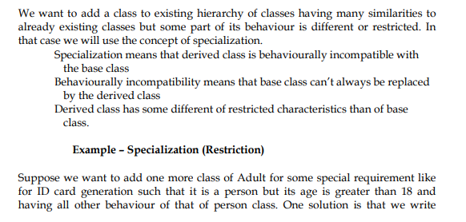


Slide 24
Example – Specialization (Restriction)
Person
age : [0..100]
…
setAge( a )
…
age = a
Adult
If age < 18 then
error
else
age = a
age : [18..100]
…
setAge( a )
…

Slide 25

Example – Specialization (Restriction)
IntegerSet
…
add( elem )
…
add element to the set
If elem < 1 then
error
else
  add element to the set
NaturalSet
…
add( elem )
…

Slide 26
Overriding
A class may need to override the default behaviour provided by its base class
Reasons for overriding
  Provide behaviour specific to a derived class
  Extend the default behaviour
  Restrict the default behaviour
  Improve performance

Slide 27
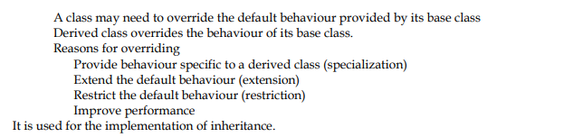
Example – Specific Behaviour
Shape
color
vertices
draw
move
setColor
Triangle
Circle
radius
Line
angle
draw
computeArea
length
draw
computeArea
draw

Slide 28
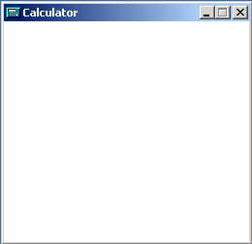
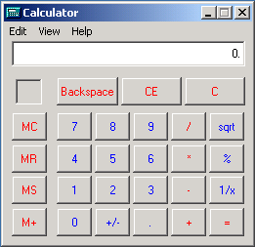
Example – Extension
Window
width
height
open
close
draw
DialogBox
1- Invoke Window’s draw
2- draw the dialog box
controls
enable
draw

Slide 29
Example – Restriction
IntegerSet
…
add( elem )
…
Add element to the set
If elem < 1 then
give error
else
  Add element to the set
NaturalSet
…
add( elem )
…

Slide 30
Example – Improve Performance
Shape
Class Circle overrides rotate operation of class Shape with a Null operation.
color
coord
draw
rotate
setColor
Circle
radius
draw
rotate

Slide 31
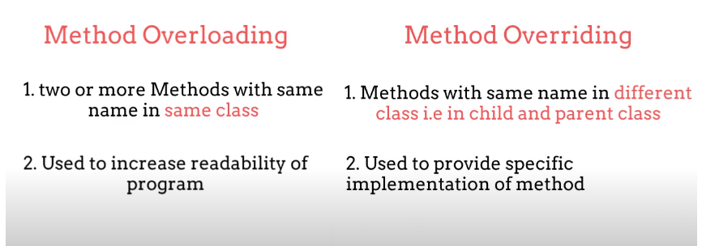

Slide 32
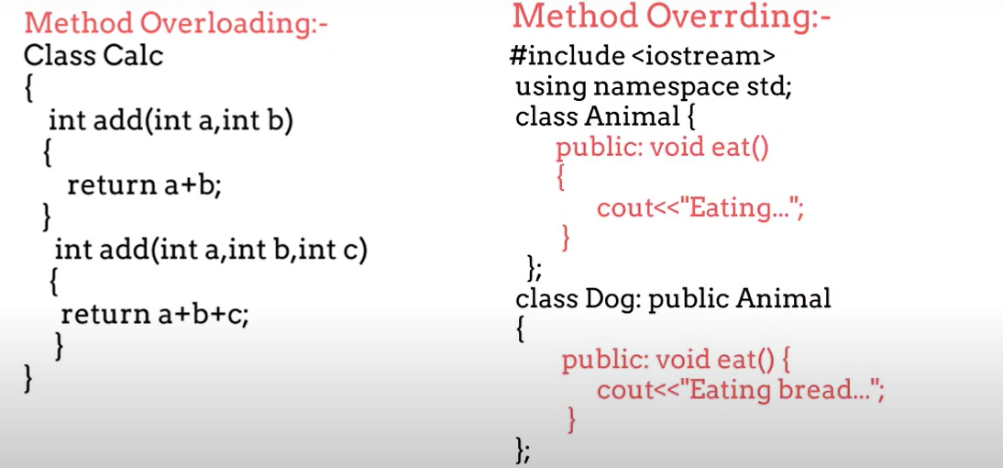

Slide 33
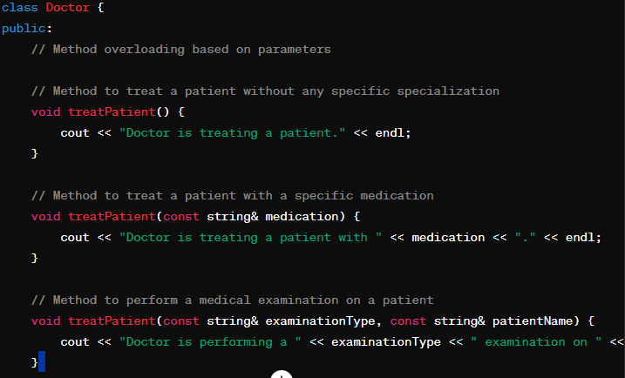
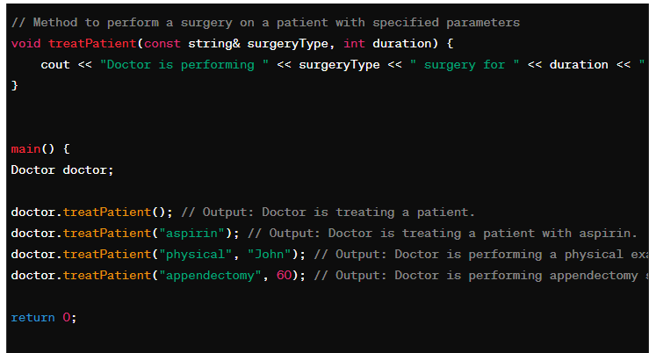
We have a class Doctor with overloaded methods named treatPatient.
The overloaded methods have the same name but different parameter lists.
We use function overloading to provide flexibility in treating patients, similar to the Java example.
This demonstrates how method overloading works in C++, allowing the Doctor class to have multiple
methods with the same name but different parameters to handle various treatment scenarios.

Slide 34
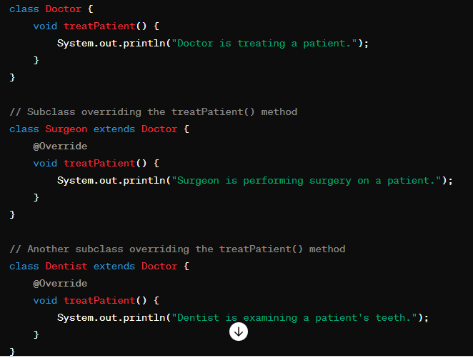
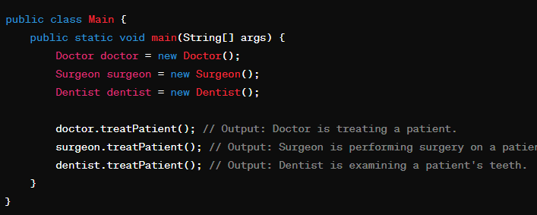

Slide 35
Abstract Classes
An abstract class implements an abstract concept
Main purpose is to be inherited by other classes
Can’t be instantiated
Promotes reuse

Slide 36
Example – Abstract Classes
Person
name
age
gender
eat
walk
Student
Doctor
Teacher
Here, Person is an abstract class

Slide 37
Example – Abstract Classes
Vehicle
color
model
accelerate
applyBrakes
Car
Truck
Bus
Here, Vehicle is an abstract class

Slide 38
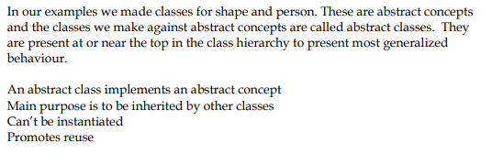

Slide 39
Concrete Classes
A concrete class implements a concrete concept
Main purpose is to be instantiated
Provides implementation details specific to the domain context

Slide 40
Example – Concrete Classes
Person
Student
Doctor
program
studyYear
Teacher
study
heldExam
Here, Student, Teacher and Doctor are concrete classes

Slide 41
Example – Concrete Classes
Vehicle
Car
Truck
Bus
capacity
load
unload
Here, Car, Bus and Truck are concrete classes

Slide 42
Basics of a Typical C++ Environment
Phases of C++ Programs:
  Edit
  Preprocess
  Compile
  Link
  Load
  Execute
Program is created in
the editor and stored
on disk.
Editor
Disk
Preprocessor
Disk
Preprocessor program
processes the code.
Compiler creates
object code and stores
it on disk.
Compiler
Disk
Linker links the object
code with the libraries,
creates an executable file and stores it on disk
Linker
Disk
Primary
Memory
Loader
Loader puts program
in memory.
Disk
.
.
.
.
.
.
Primary
Memory
CPU
CPU takes each
instruction and
executes it, possibly
storing new data
values as the program
executes.
.
.
.
.
.
.

Slide 43
Basics of a Typical C++ Environment
Common Input/output functions
  cin
    Standard input stream
    Normally keyboard
  cout
    Standard output stream
    Normally computer screen
  cerr
    Standard error stream
    Display error messages
Comments: C’s comment /* .. */ OR Begin with // or
Preprocessor directives: Begin with #
  Processed before compiling

Slide 44
fig01_02.cpp
(1 of 1) fig01_02.cpp output (1 of 1)
1 // Fig. 1.2: fig01_02.cpp
2 // A first program in C++.
3 #include <iostream>
4
5 // function main begins program execution
6 int main()
7 {
8 std::cout << "Welcome to C++!\n";
9
10 return 0; // indicate that program ended successfully
11
12 } // end function main
Welcome to C++!

